Slide 1


AMERICANA LAST MILE DELIVERY PLATFORM Technical Design – Artificial Intelligence Initiatives
RESTAURANT DIVISION
GREAT PEOPLE, GREAT
FOOD, GREAT COMPANY

Slide 2
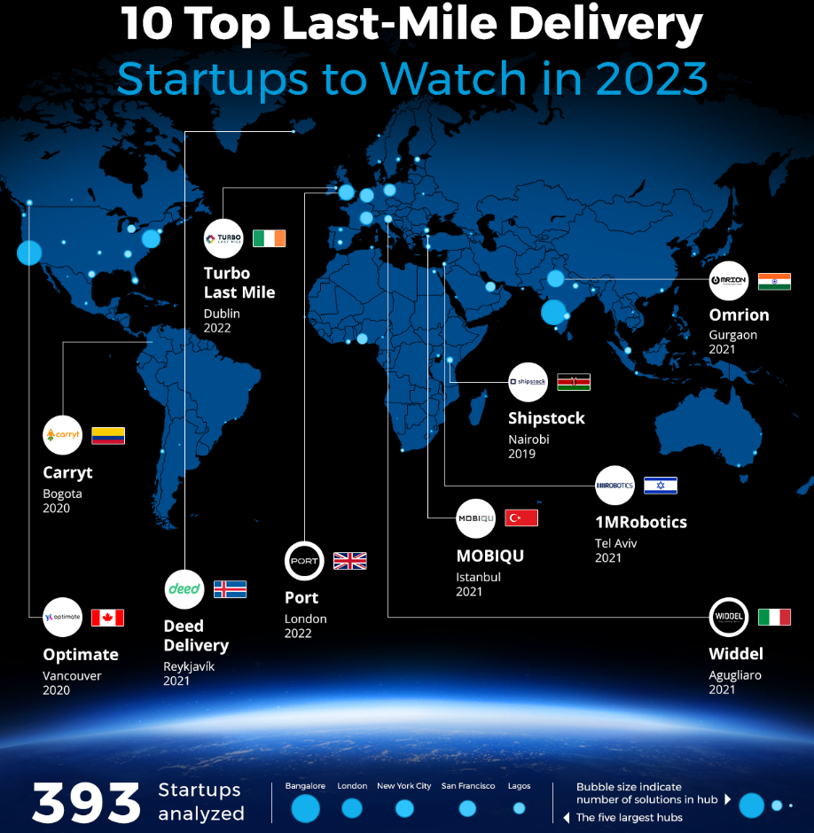
10 Top Last-Mile Delivery
Omrion – On-demand Distribution
Turbo Last Mile – Delivery Journey Optimization
Optimate – Optimal Fleet Utilization
Deed Delivery – Last-Mile Collaboration
Shipstock – eCommerce Fulfillment
MobiQu – Last-Mile Packaging
1MRobotics – Robotic Nano-Fulfillment Centers
Carryt – Last-Mile Route Optimization
Port – Last-Mile E-Hubs
Widdel – Smart Lockers for Home Delivery

Slide 3
Transforming ALMP Platform with Artificial Intelligence (AI)
Vehicle delivery route optimization
Delivery times and demand peeks predictive analysis
Faster and more efficient deliveries with autonomous vehicles and drones
Real-time tracking and updates
Most cost-effective carrier and load optimization
Address validation and correction
Sustainability initiatives
Enhanced Security
Fraud Detection
Customer behavior analysis
Customer interactions with AI chatbots
AI Delivery robots
Autonomous driving
Computer vision
Predictive analytics based on big data
Fuel Efficiency
Introducing Computer Telephony Integration (CTI) and manage the Call Center virtually.

Slide 4
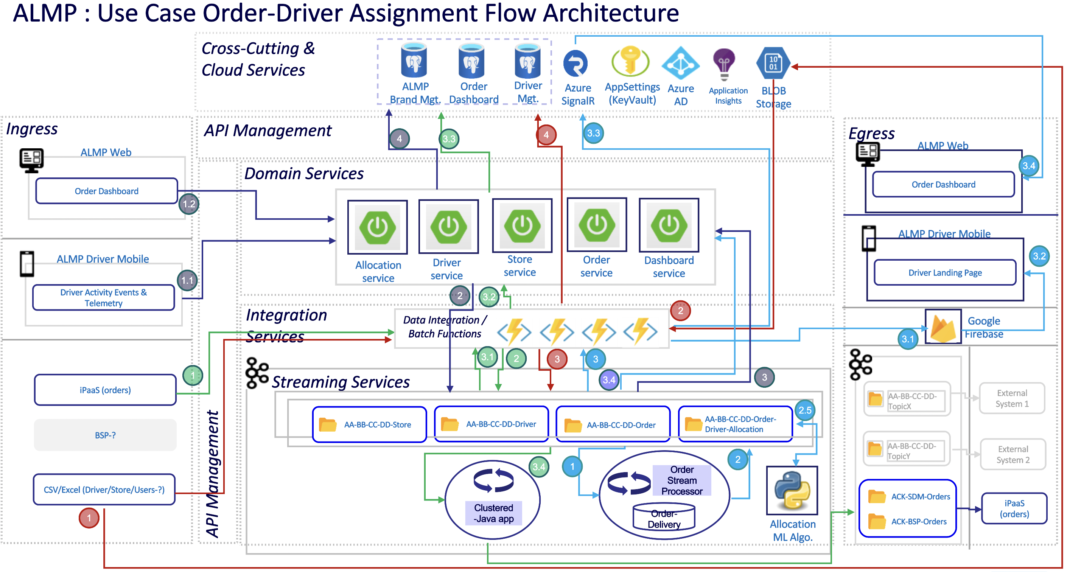
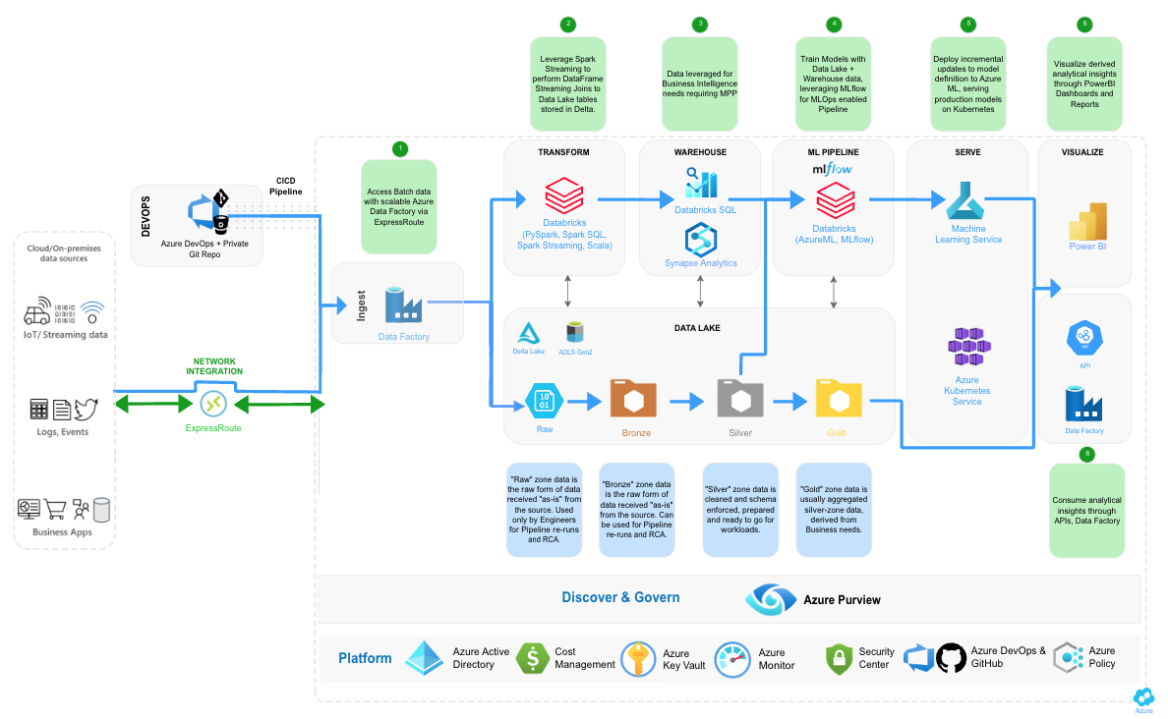
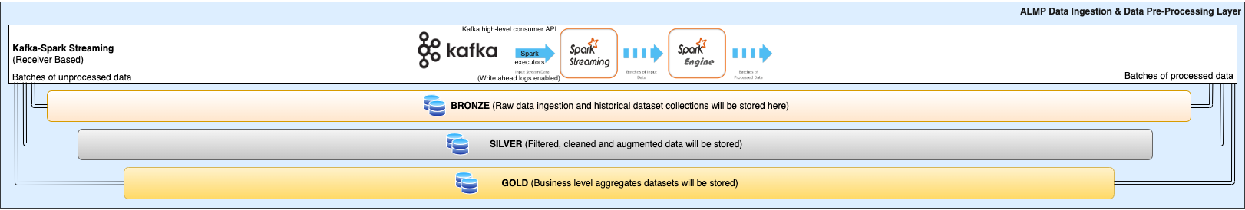
ALMP Platform Expansion – Artificial Intelligence Enabled Platform

Slide 5
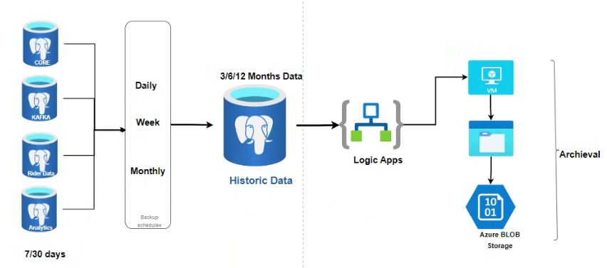
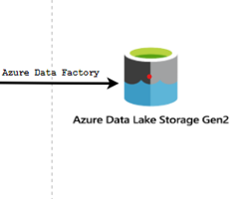
6 Months Data
100% Data

Slide 6
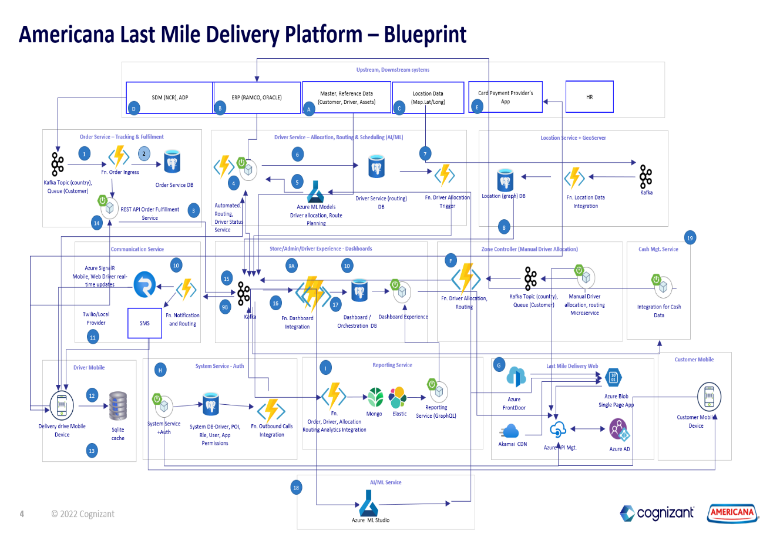

Slide 7
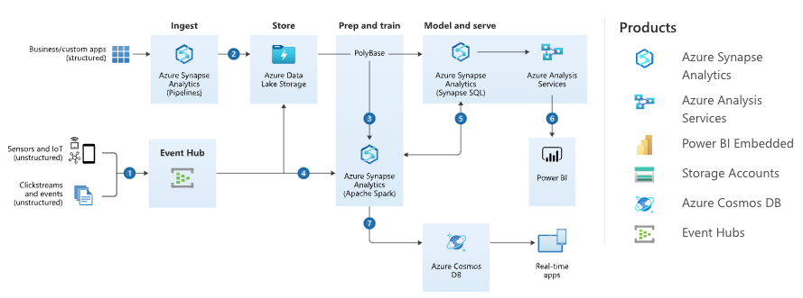
Rider Vehicle Tracking Enablement with IoT & Telemetry

Slide 8
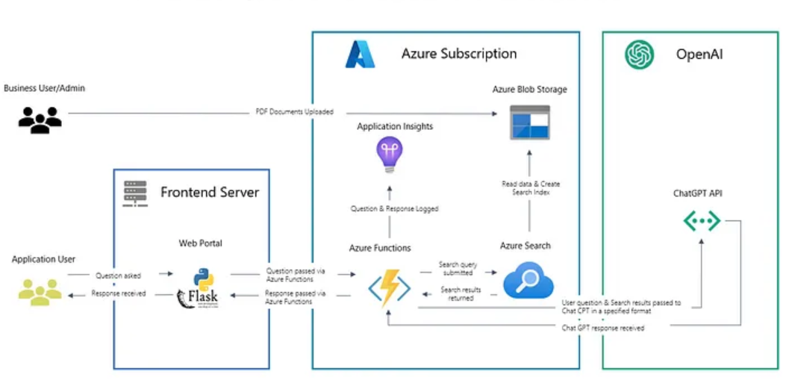
Architecture Diagram for Chat GPT enabled Order Search

Slide 9
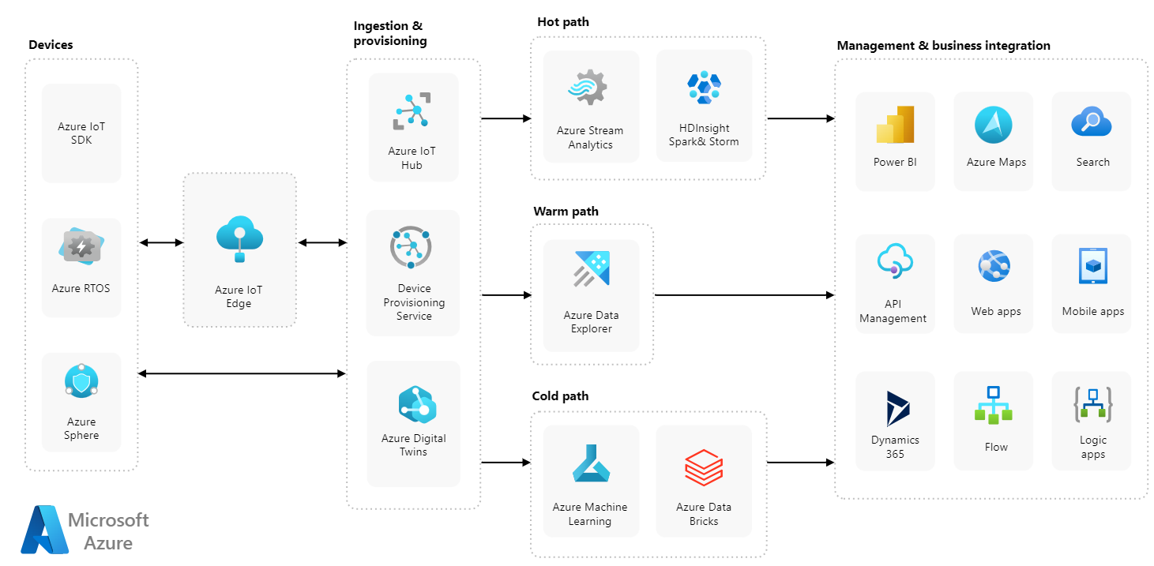
Azure IoT Reference Architecture

Slide 10
ALMP Database Requirements
ALMP system has data types with structured, semi-structured and unstructured for that need below are the data storage solutions which needs to be used with cloud services:
Type of Usages | Data Storage Types | Suggested Solutions | Remarks
Transactions (OLTP) | Relational/No-SQL | PostgreSQL/MongoDB
Analytics (OLAP) | Columnar | Azure Synapse
Dictionary | Key-Value | Redis
Cache | In-memory | Redis
2-D Key Value | Wide Column | Cosmos DB/MongoDB
Time Series | Time Series | Cosmos DB/MongoDB
Audit Trail | Immutable Ledger | Azure SQL
Location & Geospatial | JSON Data | Cosmos DB/MongoDB
Entity Relationship | Graph | Cosmos DB/MongoDB
Nested Objects (XML, JSON) | Documents | Cosmos DB/MongoDB
Full Text Search | Text Search | APIs
Rich Text | Blob | Cloud Storage
Data Lake | All | Azure Data Lake/MongoDB Data Lake

Slide 11
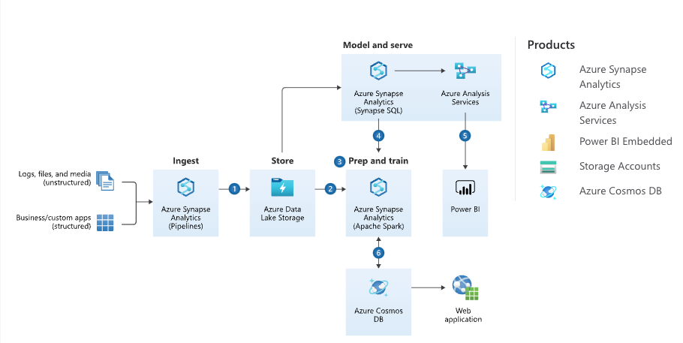

Slide 12
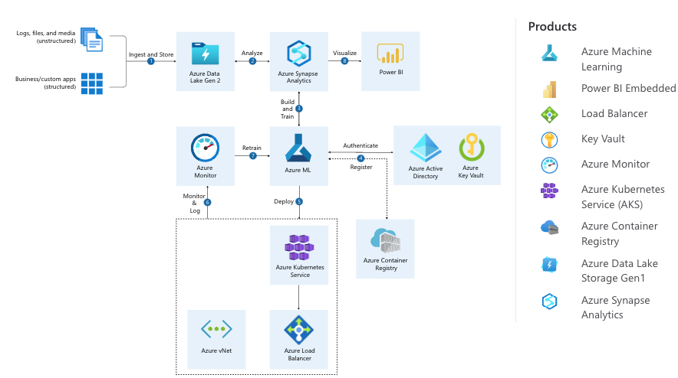
Azure Machine Learning Platform

Slide 13
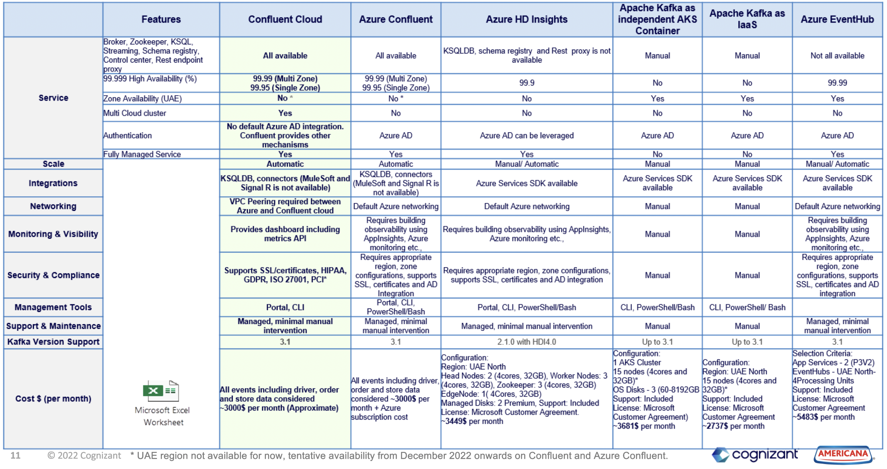
Kafka Event Streaming for ALMP – Available Solutions and Selection Criteria​

Slide 14


